Slide 1
Matchmaking - Finding the Right Drug for Actionable Alteration-Positive NSCLC
Gregory Riely
Ning Zhao and Ge Li Endowed Chair for Lung Cancer Research
Memorial Sloan Kettering Cancer Center

Slide 2
Target | Available |  |  | Most common
EGFR (Exon 19 del, L858R, G719, L861) | gefitinib afatinib dacomitinib erlotinib | osimertinib erlotinib + ramucirumab osimertinib + chemotherapy amivantimab + lazertinib | Erlotinib Osimertinib Erlotinib + Ramucirumab | osimertinib+chemotherap[
EGFR (exon 20) | amivantamab+/-chemotherapy |  |  | amivantamab +/- chemotherapy
ALK fusions | crizotinib alectinib | ceritinib brigatinib lorlatinib | Ceritinib Brigatinib lorlatinib | lorlatinib
BRAF V600E | dabrafenib +trametinib encorafenib + binimetinib |  |  | encorafenib + binimetinib
ROS1 fusions | crizotinib ceritinib |  | entrectinib repotrectinib taletrectinib | entrectinib, repotrectinib, taletrectinib
NTRK fusions | larotrectinib, entrectinib |  |  | larotrectinib, entrectinib
RET fusions | selpercatinib, pralsetinib |  |  | selpercatinib, pralsetinib
MET exon 14 | capmatinib, tepotinib |  |  | capmatinib, tepotinib
ERBB2 (HER2) mut | trastuzumab deruxtecan*, zongertinib* |  |  | trastuzumab deruxtecan*, zongertinib*
KRAS G12C | adagrasib*, sotorasib* |  |  | adagrasib*
*second-line approvals

Slide 3
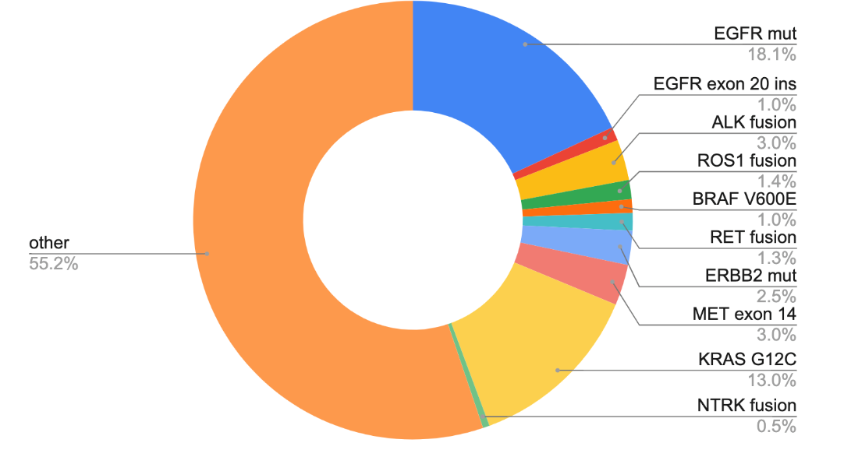
Lung cancer molecular subtypes with FDA-approved agents
AACR GENIE BPC lung, Data available at https://genie.cbioportal.org/
Notes:
NCCN Clin Info MH 3/28/23: this repeats slides 10, 18, 51

Slide 4
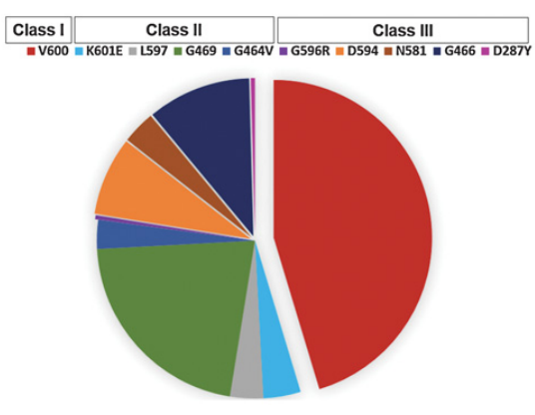
There are many types of BRAF mutations
 | Category | examples
Class 1 | Ras independent, signal as active monomers | V600
Class 2 | Ras independent, constitutively active dimers | K601, L597, G469, G464, fusions
Class 3 | Ras dependent, impaired/dead kinase activity | D287, V459, G466, S467, D594
Yao et al, Nature 2017, Dagogo-Jack et al, CCR 2019

Slide 5
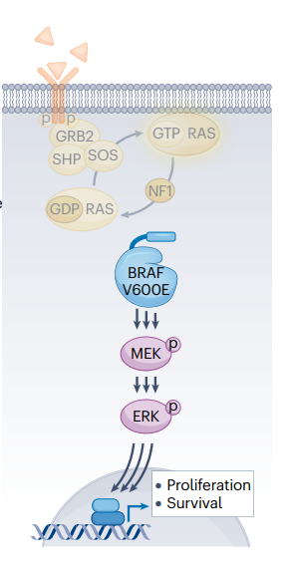
Targeting BRAF is best done with combined inhibition of BRAF and MEK
Inhibiting BRAF
Inhibiting MEK
Hanrahan et al, Nat Rev Clin Onc 2024; Planchard et al, JTO 2022; Riely et al, JCO 2023, Riely et al, JTO 2024

Slide 6
Targeting BRAF is best done with combined inhibition of BRAF and MEK
 | First Line |  | Second Line
 | RR | mPFS | RR | mPFS
Dabrafenib + Trametinib | 68% | 11 months | 64% | 10 months
Encorafenib + Binimetinib | 75% | 30 months | 46% | 9 months
Inhibiting BRAF
Inhibiting MEK
Hanrahan et al, Nat Rev Clin Onc 2024; Planchard et al, JTO 2022; Riely et al, JCO 2023, Riely et al, JTO 2024

Slide 7
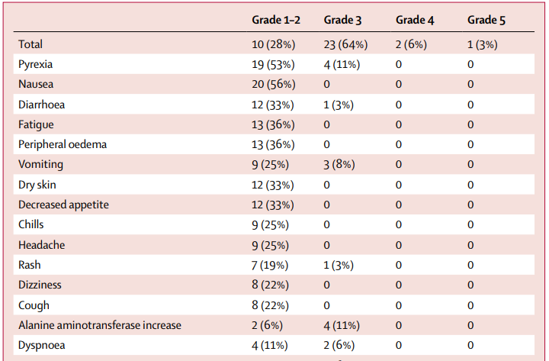
Dabrafenib (BRAF inhibitor) + Trametinib (MEK inhibitor) toxicities include pyrexia, nausea, diarrhea
Modified from Planchard et al, Lancet Onc 2017

Slide 8
Encorafenib + Binimetinib toxicities include nausea, diarrhea, but pyrexia is much less common
most common TRAEs (≥15%) by treatment line
Treatment naive (n=59)
Previously treated (n=39)
Nausea
59%
41%
Diarrhea
41%
49%
All treatment-related events of pyrexia were grade 1 or 2
Fatigue
31%
33%
Vomiting
31%
28%
 | Grade 1 | Grade 2
Treatment naive | 10% | 2%
Previously treated | 3% | 0%
Vision blurred
20%
15%
ALT increased
19%
5%
AST increased
19%
5%
Anemia
17%
18%
Grade 1
Constipation
15%
13%
Grade 2
Pruritus
10%
15%
Grade 3/4
Asthenia
5%
18%
60
40
20
0
20
40
60
Patients, %
Riely et al, JTO 2025

Slide 9
For patients with metastatic BRAF V600E, standard initial therapy is with a combination of BRAF and MEK inhibition
BRAF inhibitor
Dabrafenib
Encorafenib
+
OR
+
MEK inhibitor
Trametinib
Binimetinib
Note: no randomized data comparing with chemotherapy or chemotherapy/immunotherapy

Slide 10
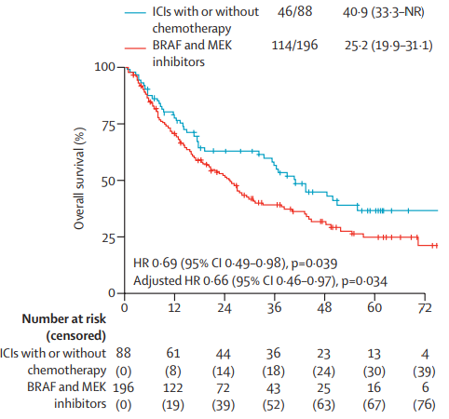
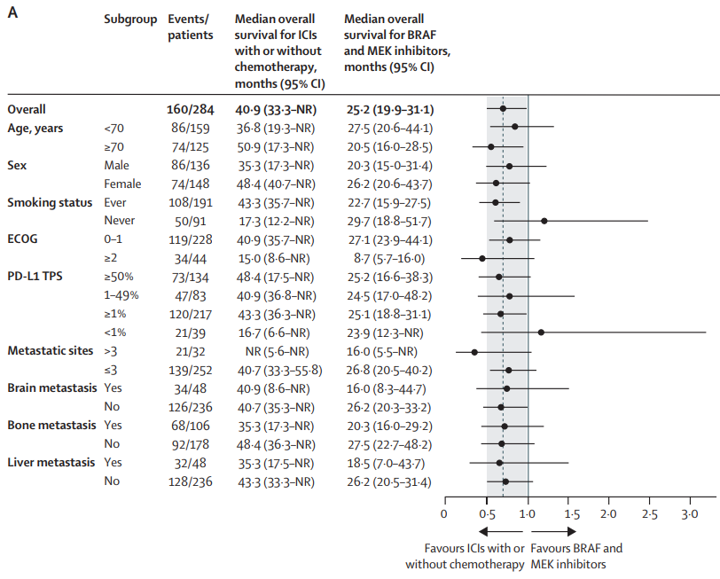
Front-line treatment with ICI+/-chemotherapy may be as/more effective than targeted therapy, (less true in never smokers, PD-L1 negative)

Slide 11
MET exon 14 mutations occur in a small proportion of patients with NSCLC
Lung cancer molecular subtypes with FDA-approved agents
AACR GENIE BPC lung, Data available at https://genie.cbioportal.org/
Notes:
NCCN Clin Info MH 3/28/23: this repeats slides 10, 18, 51

Slide 12
MET Exon 14 Alterations in NSCLC
Happen in 4-5% of patients with NSCLC
More likely in elderly patients
Some association with sarcomatoid histology

Slide 13
There are two FDA-approved agents for targeting MET exon 14 positive NSCLC
 | First Line |  | Second Line
 | RR | mPFS | RR | mPFS
Capmatinib | 68% | 12.5 mo | 44% | 6 mo
Tepotinib | 57% | 12.6 mo | 45% | 11 mo
Mazieres et al, JAMA ONC 2023; Wolf et al, Lancet Onc 2024

Slide 14
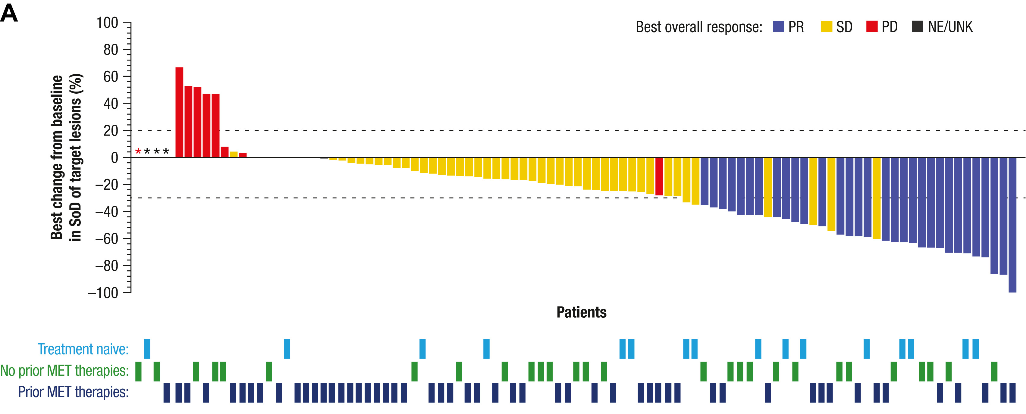
Amivantamab also has some efficacy in patients with MET exon 14
Treatment Naïve
Overall RR – 50%
mDOR – 3.2 mo
mPFS – 5 mo
Note:
RR after prior MET – 19%
EGFR
MET
Krebs et al, JTO 2025

Slide 15
For patients with metastatic MET exon 14 alterations, standard initial therapy is with a MET inhibitor
Capmatinib
OR
Tepotinib
Note: no randomized data comparing these targeted therapies to each other or with chemotherapy or chemotherapy/immunotherapy

Slide 16
KRAS mutant NSCLC
~25% of Patients with NSCLC have KRAS mutations
The most common KRAS mutation in NSCLC is G12C
Arbour et al, CCR 2017

Slide 17
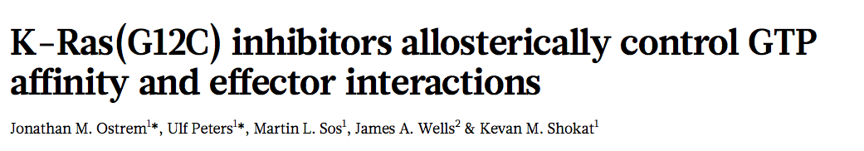
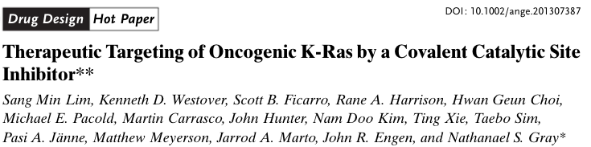
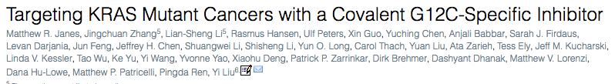
The New Hope – Direct RAS inhibitors
Nature 2013
Angewandte Chemie International Edition 2013
Cell 2018

Slide 18
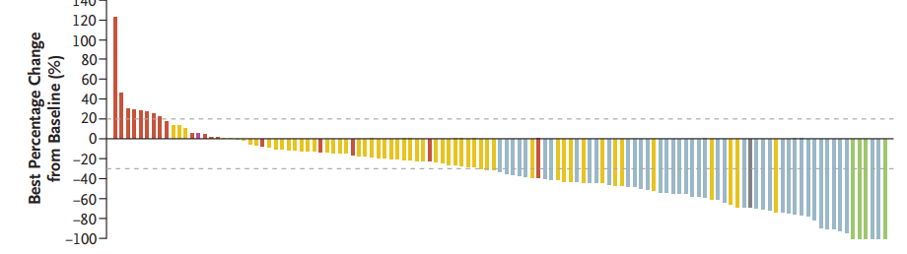
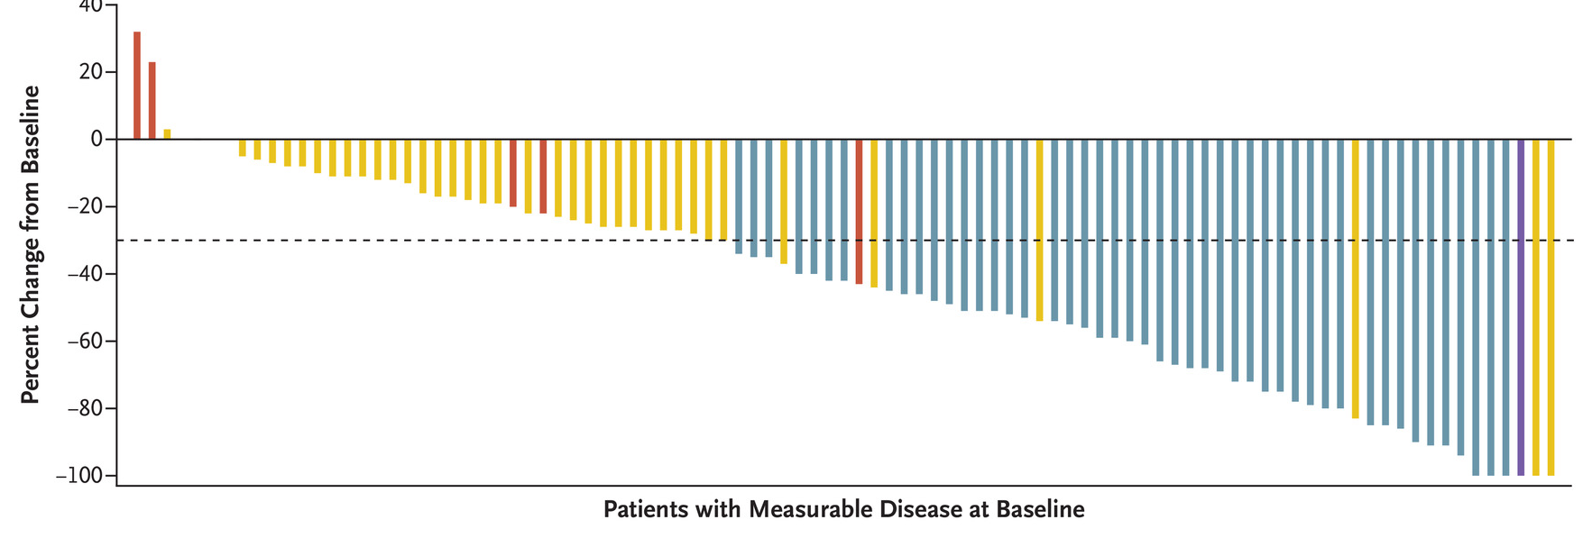
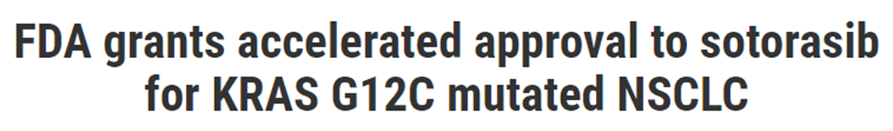
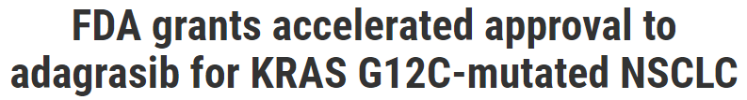
In phase 1/2 trials, activity of direct targeted therapy against KRAS G12C leads to FDA approvals
sotorasib
adagrasib
Skoulidis et al, NEJM 2021; Jänne PA et al. NEJM, 2022;387(2):120-31.

Slide 19
Evaluating these drugs KRAS G12C NSCLC
KRAS G12C targeted therapy
Recurrent/metastatic NSCLC
Previous therapy with platinum-doublet and immunotherapy
KRAS G12C
Docetaxel

Slide 20
In randomized trials, KRAS G12C drugs have better RR and PFS than docetaxel in patients with KRAS G12C NSCLC
 | RR | mPFS | PFS HR | P value
Sotorasib | 28% | 5.6 months | 0.66 | P=0.0017
Docetaxel | 13% | 4.5 months
Adagrasib | 32% | 5.5 months | 0.58 | P<0.0001
Docetaxel | 9% | 3.8 months
Barlesi et al, Lancet 2025
Langen et al Lancet 2023

Slide 21
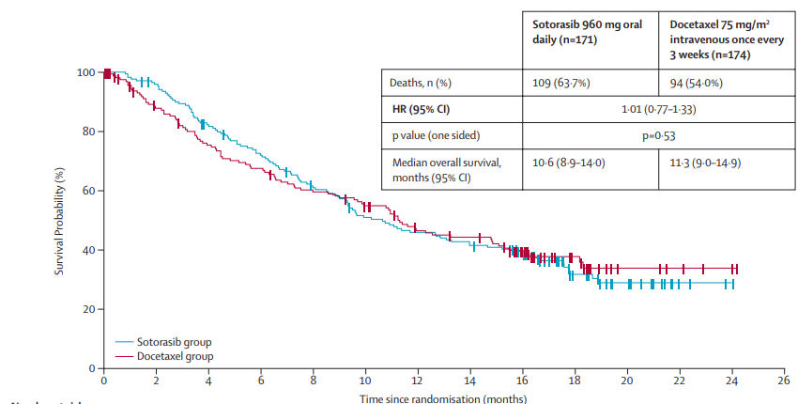
Sotorasib does not Improve Overall Survival (compared with docetaxel)
Langen et al Lancet 2023

Slide 22
Summary
For BRAF V600E, combination MEK/BRAF inhibition with either dabrafenib/trametinib or encorafenib/binimetinib is standard first line therapy
For MET exon 14 alterations, MET inhibitors such as capmatinib and tepotinib are standard first line therapy
For KRAS G12C, targeted therapies are considered second-line therapy (they are being explored in trials for 1st line combinations)

